Slide 1
Les Petites Betes – Mini beasts
Look at all these pictures and words for mini beasts in French.
Have a go at spotting as many as you can.
Each time you see one, check what it’s called in French.
If you can print the page, tick each one when you see it.
Put a tick every time you see another one.

Slide 2
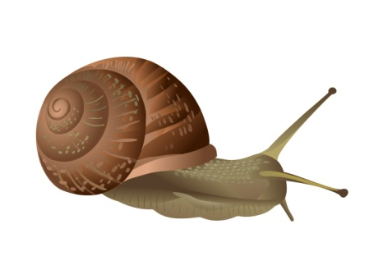
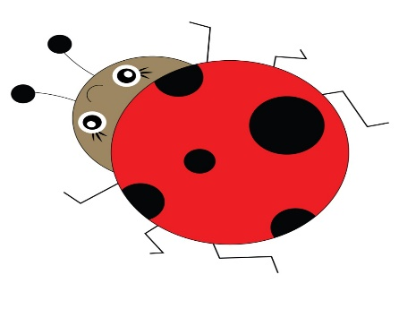
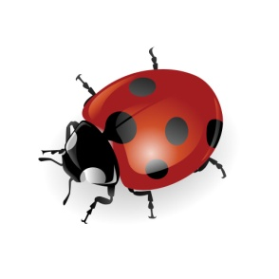
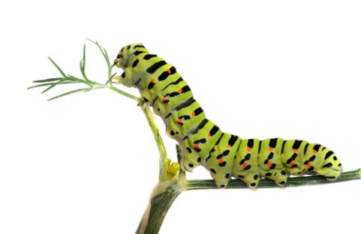
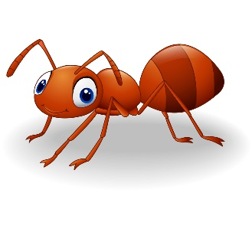
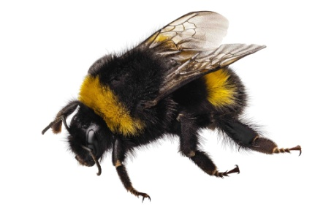
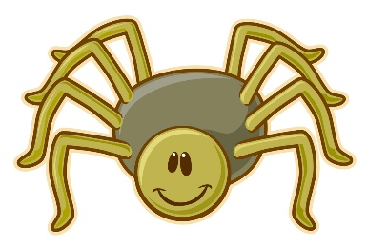
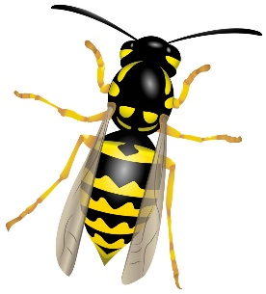
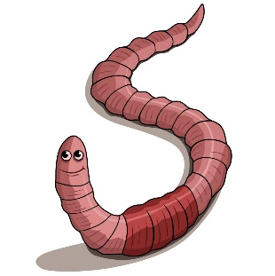
un escargot
un papillon
une coccinelle
un fourmi
une abeille
une chenille
une araignée
une guepe
un ver

